Slide 1




Faculty Development Programme on
Advanced Research Techniques in Finance
A PROGRAMME FOR THE TEACHERS AND RESEARCHERS
Nov. 16-21, 2015
SOFTWARE INSTALLATION MANUAL:
SPSS | EVIEWS | STATA | MENDELEY

Slide 2
Initial Thoughts
The 4 things that you need to operate a software are…
THE SOFTWARE ITSELF: You can find SPSS, EViews 8, STATA 13 and Mendeley in your SanDisk pen drive as of now for this workshop.
A GOOD TEACHER who can familiarize you with the software, tell you the basics and provide you a hands-on experience with practical examples and application oriented pedagogy.
CONFIDENCE & SELF BELIEF is very important to learn any software. Be positive that you can learn and use a software on your own. If you are determined and patient enough, you will soon find it easy to operate a software.
GOOGLE: World’s best personal assistant is there to help you at every step. Whenever in doubt, just GOOGLE. It is a very powerful source of help.
Let’s get started by installing SPSS, EViews 8, STATA 13 and Mendeley

Slide 3
SPSS Installation…

Slide 4
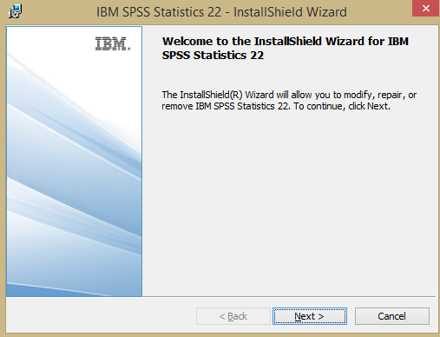
SPSS Installation
Please follow the steps below to install SPSS on your system:
Step 1: Open the folder named ‘SPSS v22’ in your SanDisk pen drive
Step 2: Double click on SPSS_Statistics_22_TR_win32_.exe file
Step 3: A dialog box shall appear on your screen asking to confirm the requisite changes on your system by the SPSS program. Click on YES. SPSS installation shall start. SPSS InstallShield Wizard shall open as shown below.
Step 4: Click on ‘Next’

Slide 5
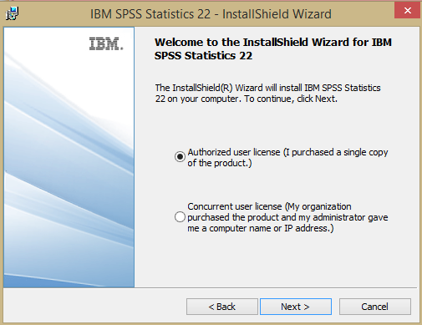
SPSS Installation
5. Step 5: Select the radio button “Authorized user license”. Click on ‘Next’

Slide 6
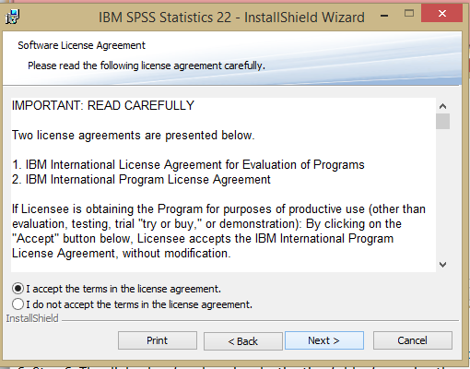
SPSS Installation
6. Step 6: The license agreement dialog box as shown above shall appear. Select the radio button “I accept the terms in the license agreement.” Click on ‘Next’

Slide 7
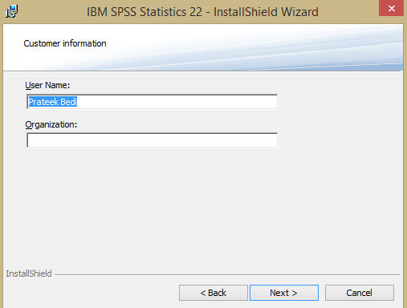
SPSS Installation
7. Step 7: The Customer Information dialog box as shown above shall appear. Click on ‘Next’

Slide 8
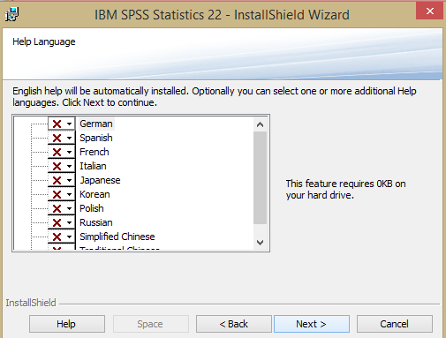
SPSS Installation
8. Step 8: The Language dialog box as shown above shall appear. English shall be automatically installed. Click on ‘Next’

Slide 9
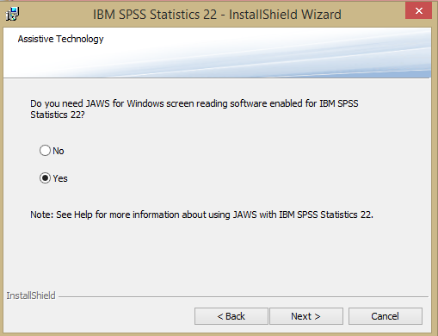
SPSS Installation
9. Step 9: The Assistive Technology dialog box as shown above shall appear. Select ‘Yes’. Click on ‘Next’

Slide 10
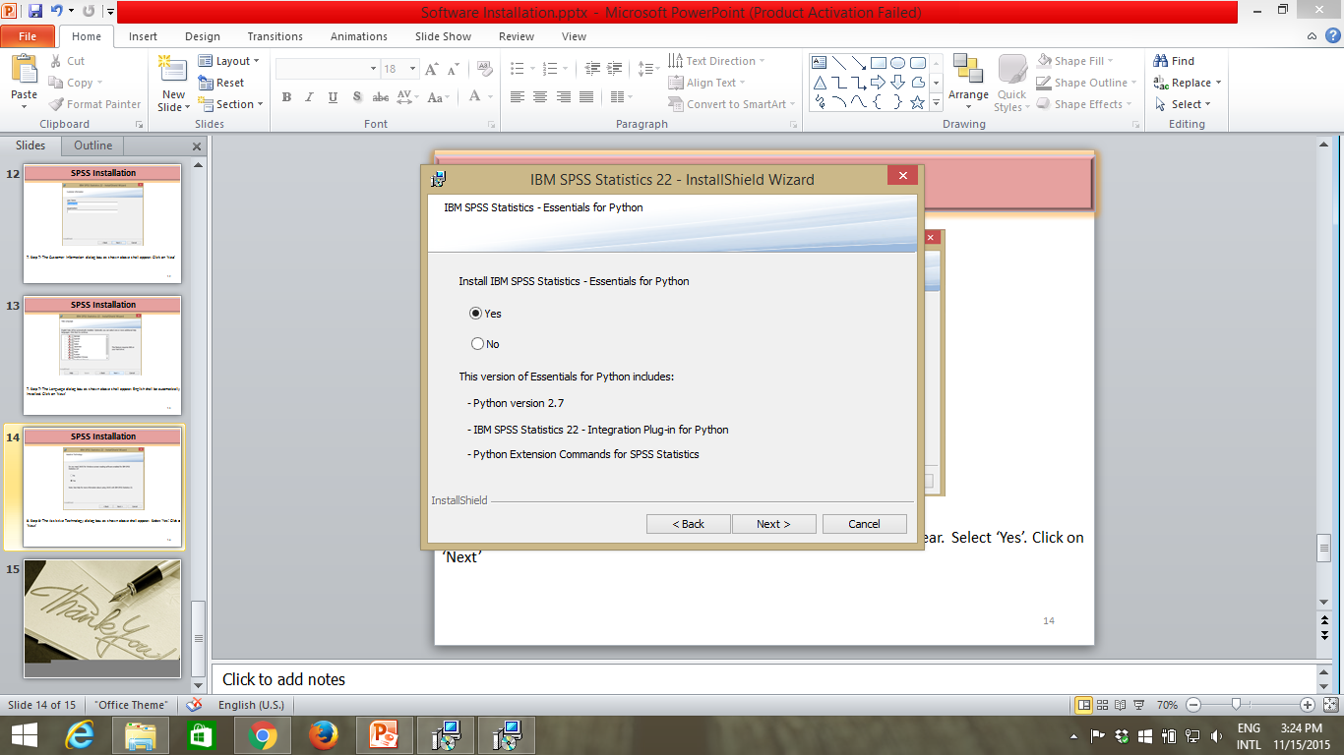
SPSS Installation
10. Step 10: The Essential For Python dialog box as shown above shall appear. Select ‘Yes’. Click on ‘Next’

Slide 11

SPSS Installation
11. Step 11: The Software License Agreement dialog box as shown above shall appear. Select ‘I accept the terms in the license agreement’. Click on ‘Next’

Slide 12
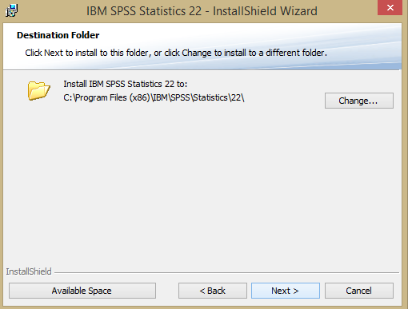
SPSS Installation
12. Step 12: The Destination Folder dialog box as shown above shall appear. The software is stored in C Drive’s Program Files (x86) folder by default. Click on ‘Next’.

Slide 13
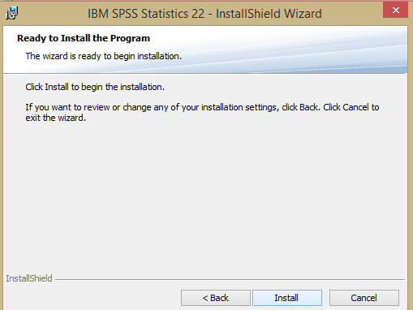
SPSS Installation
13. Step 13: The Ready to Install dialog box as shown above shall appear. Click on ‘Install’. The installation shall begin. This may take several minutes.

Slide 14
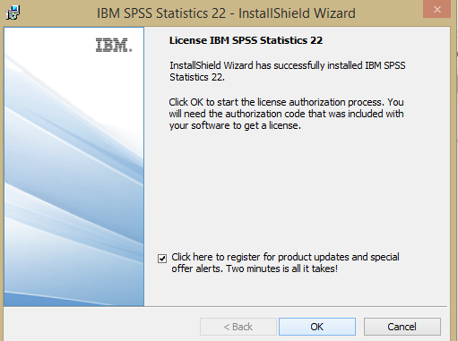
SPSS Installation
14. Step 14: The License Authorization dialog box as shown above shall appear. Click on ‘OK’.

Slide 15
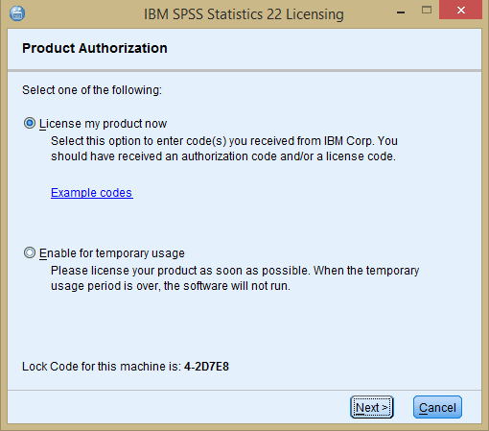
SPSS Installation
15. Step 15: The Product Authorization window as shown above shall appear. Click on ‘Next’.

Slide 16
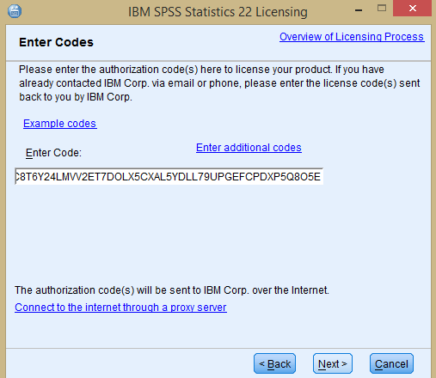
SPSS Installation
16. Step 16: The Enter Code window as shown above shall appear. Now go back to the SPSS v22 Folder in your pen drive. There is a notepad file called Key. Open it. Cope the entire code written therein. Paste this code in the above window in the space provided. Click on ‘Next’.

Slide 17
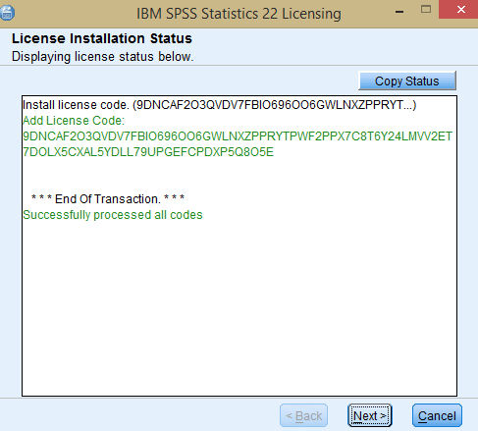
SPSS Installation
17. Step 17: The License Installation Status window as shown above shall appear. Click on ‘Next’.

Slide 18
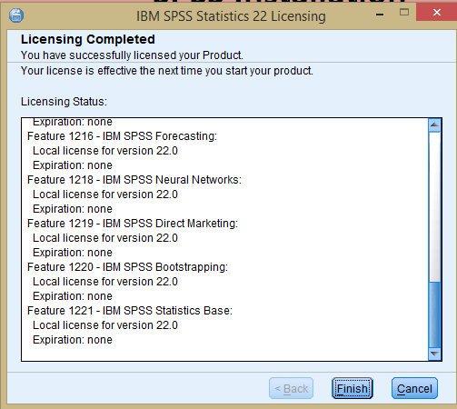
SPSS Installation
18. Step 18: The Licensing Completed window as shown above shall appear. Click on ‘Finish’. SPSS 22 is now installed. You can go the Start Menu and type ‘IBM SPSS Statistics 22’. Click on the suggested application and SPSS shall open.

Slide 19
EViews Installation…

Slide 20
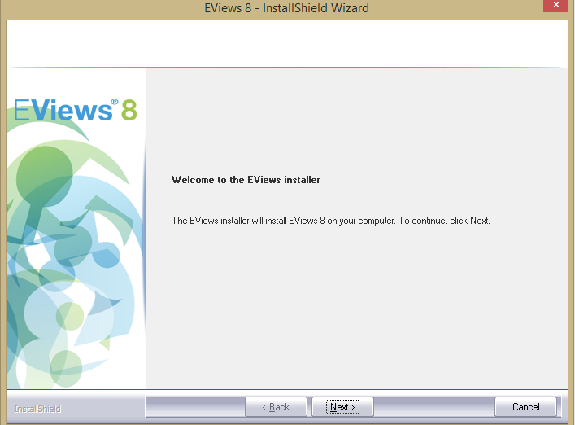
EViews 8 Installation
For installation of EViews, you will have to disable your anti-virus during the installation process. In your Anti-virus program you should get an option to disable the anti-virus under settings or status menu. If you are not able to disable the anti-virus, you will not be able to install EViews 8 .
Please follow the steps below to install EViews 8 on your system:
Step 1: Open the folder named ‘EViews 8’ in your SanDisk pen drive
Step 2: Double click on EViews8Installer.exe file
Step 3: A dialog box shall appear on your screen asking to confirm the requisite changes on your system by the EViews program. Click on YES. EViews InstallShield Wizard shall open.
Step 4: Click on ‘Next’

Slide 21
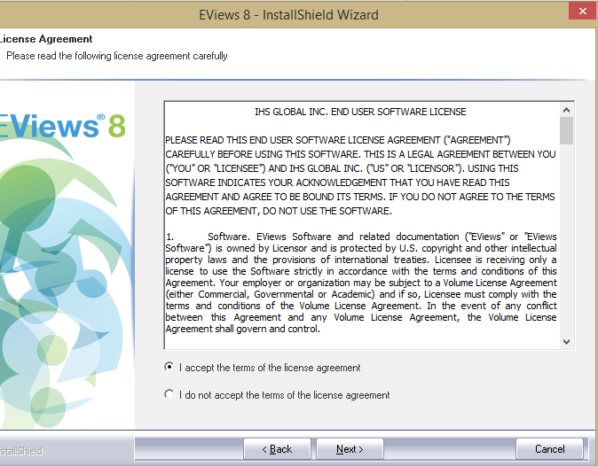
EViews 8 Installation
5. Step 5: Select the radio button “I accept the terms of the license agreement”. Click on ‘Next’
6. Step 6: The dialog box for choosing destination folder for saving the software shall appear. Click ‘Next’ and EViews shall be saved in C Drive’s ‘Program Filesx86’ folder.

Slide 22
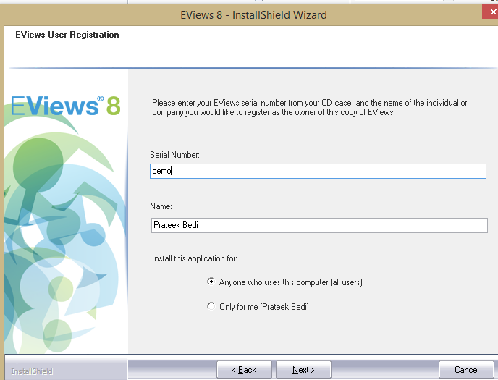
EViews 8 Installation
7. Step 7: Type demo in the box for Serial Number. ‘Click Next’.
8. Step 8: A dialog box for feature selection shall appear. All features are selected by default. Click ‘Next’.
9. Step 9: A dialog box for selecting a Start Menu Folder for EViews shall appear. Click ‘Next’.

Slide 23
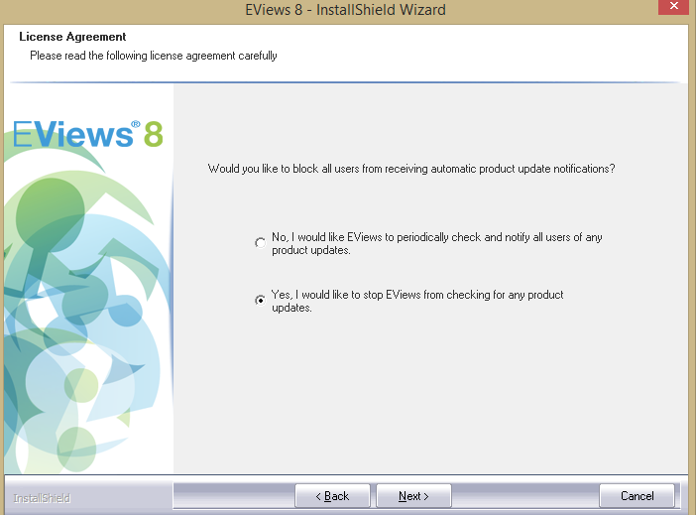
EViews 8 Installation
10. Step 10: The License Agreement dialog box shall appear as shown above. Select the option “Yes, I would like to stop EViews from checking for any product updates”. Click ‘Next’.
11. Step 11: The installation process shall begin. Sit back and relax.

Slide 24
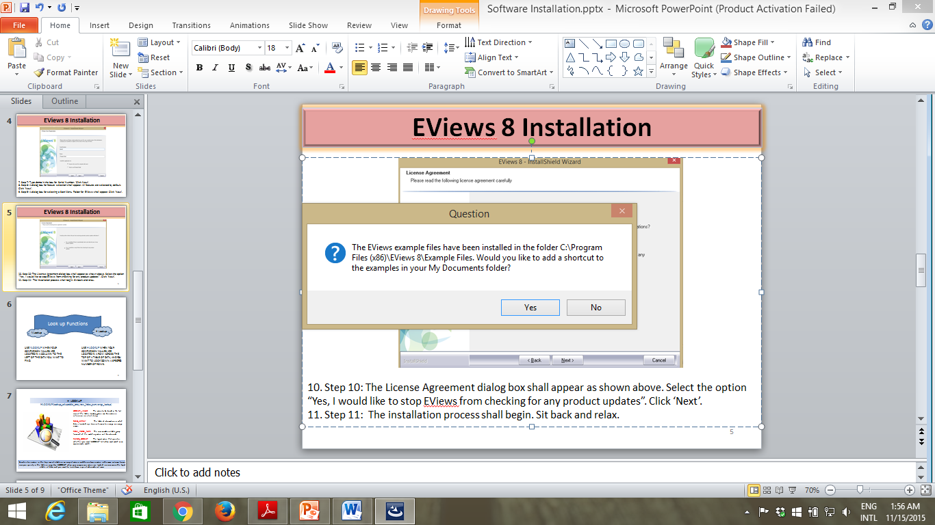
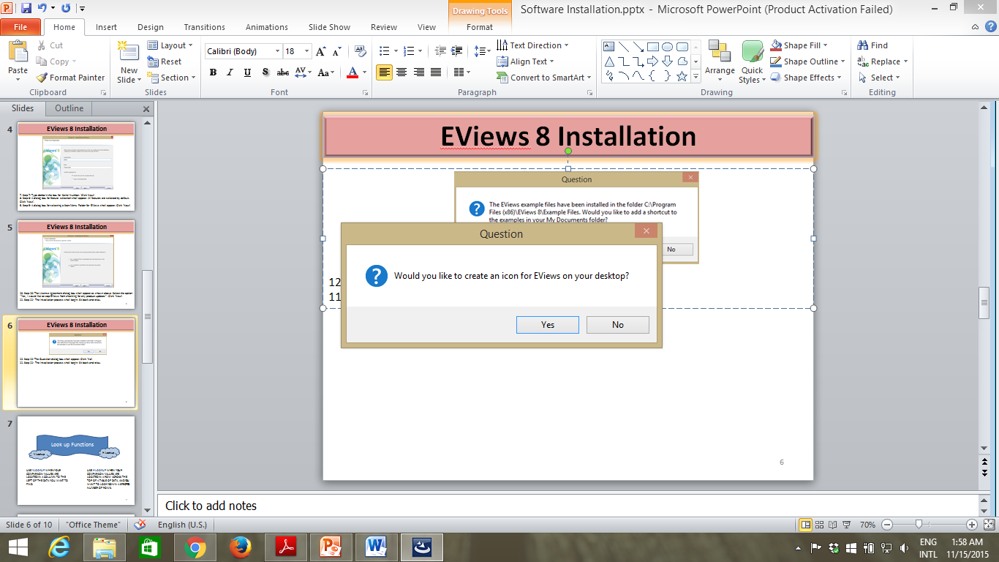
EViews 8 Installation
12. Step 12: The Question dialog box as shown above shall appear. Click ‘No’.
13. Step 13: The Question dialog box asking for creation of a desktop shortcut to EViews 8 shall appear (as shown above). Click ‘Yes’

Slide 25
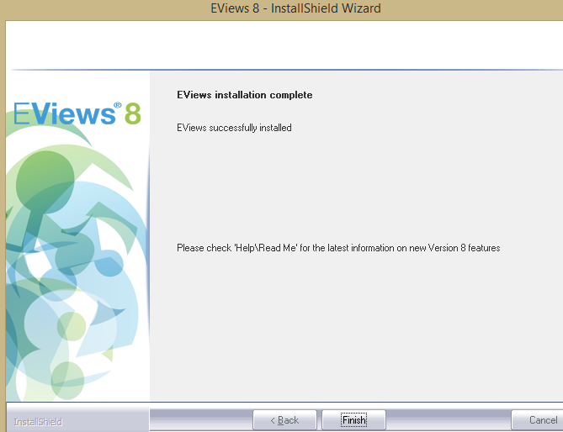
EViews 8 Installation
14. Step 14: The window for EViews Installation Completion shall appear (as shown above). Click ‘Finish’. The EViews 8 Folder showing the list of files installed will appear. Enjoy the power of EViews 8!

Slide 26
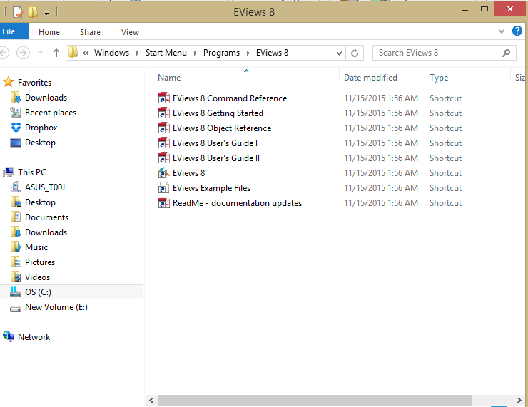
EViews 8 Installation
15. Step 15: The EViews 8 Folder showing the list of files installed will appear. Close this window.

Slide 27
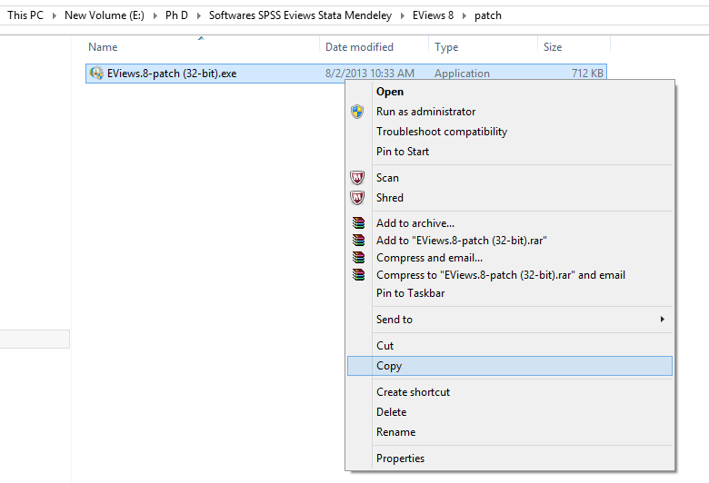
EViews 8 Installation
16. Step 16: Open the EViews 8 folder in your pendrive. Open the ‘patch’ folder. Copy the application named “EViews.8-patch (32-bit).exe”.
If you don’t see “EViews.8-patch (32-bit).exe” and only see “EViews.8-patch (32-bit).rar”, extract the “EViews.8-patch (32-bit).rar” file using WinRAR application. For this, right click on “EViews.8-patch (32-bit).rar” and click on “Extract here”. Now, copy the application named “EViews.8-patch (32-bit).exe”.
Now go to C drive of your system. Open the folder named “Program Files (x86). Open the folder named “EViews 8”. Paste the copied “EViews.8-patch (32-bit).exe” file here.

Slide 28
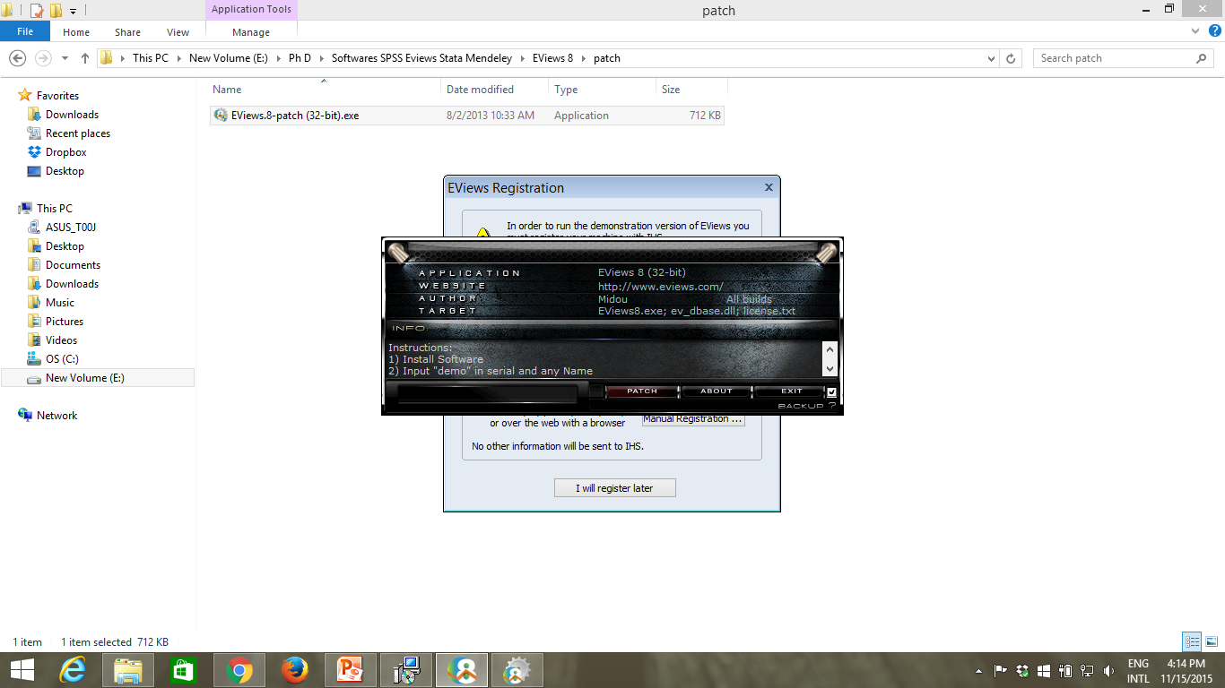
EViews 8 Installation
17. Step 17: After pasting the “EViews.8-patch (32-bit).exe” file in EViews 8 folder, double click on this file to run it. Click “Yes” on the dialog box that appears to allow the software to make changes to your system. The following black box appears (with music in the background). Click on “Patch” button. The patch file shall run. Soon you will see a “DONE” button in the bottom of this black box. Click on the “DONE” button. And then click “EXIT” button. The black box shall be closed (and the music shall stop).
18. Step 18: Go to your desktop and double click on “Eviews 8” icon to open the software.
Now go to C drive of your system. Open the folder named “Program Files (x86). Open the folder named “EViews 8”. Paste the copied “EViews.8-patch (32-bit).exe” file here.

Slide 29
STATA Installation…

Slide 30
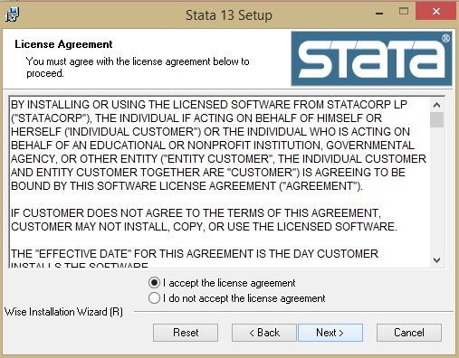
STATA Installation
Please follow the steps below to install STATA on your system:
Step 1: Open the folder named ‘STATA v13’ in your SanDisk pen drive.
Step 2: Double click on Stata13_setup.exe file
Step 3: STATA Installation Wizard shall open. Click on ‘Next’.
4. Step 4: The License Agreement window shall appear. Select “I accept the license agreement”. Click on ‘Next’

Slide 31
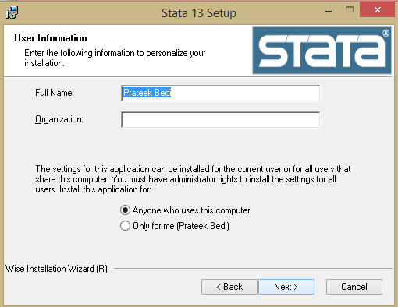
STATA Installation
5. Step 5: The User Information dialog box appears. Click on ‘Next’.

Slide 32
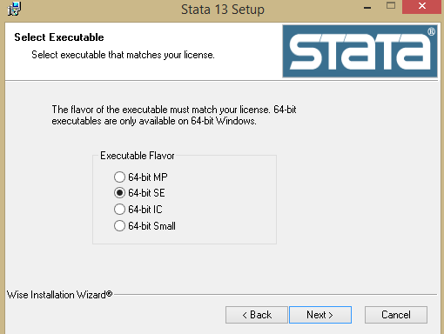
STATA Installation
6. Step 6: The Select Executable dialog box appears as shown above. Select “64-bit SE”. Click on ‘Next’.
7. Step 7: The destination folder dialog box appears. Click on ‘Next’. The STATA software is saved in C Drives’ Program Files (x86) folder by default.

Slide 33
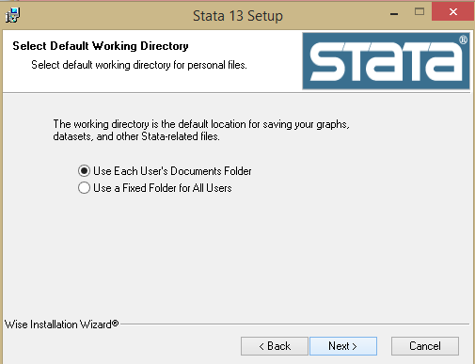
STATA Installation
8. Step 8: The Select Default Working Directory dialog box appears as shown above. Click on ‘Next’.
9. Step 9: The Ready to Install dialog box appears. Click on ‘Next’ to start the installation process.

Slide 34
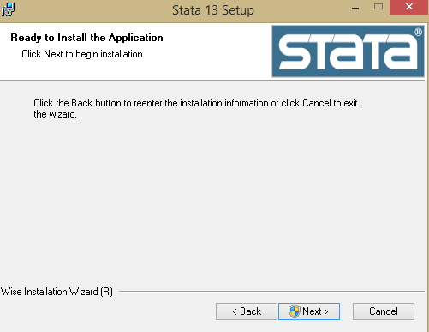
STATA Installation
10. Step 10: The Ready to Install dialog box appears. Click on ‘Next’ to start the installation process. The installation process starts. A dialog box called “User Account Control” appears. Click on Yes. Sit back and relax.

Slide 35
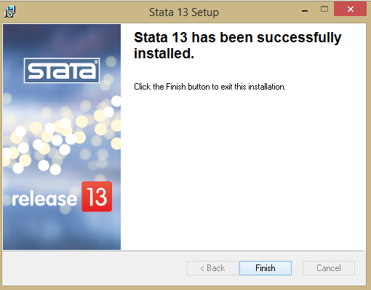
STATA Installation
11. Step 11: The Stata 13 successful installation dialog box appears. Click on ‘Finish’.

Slide 36
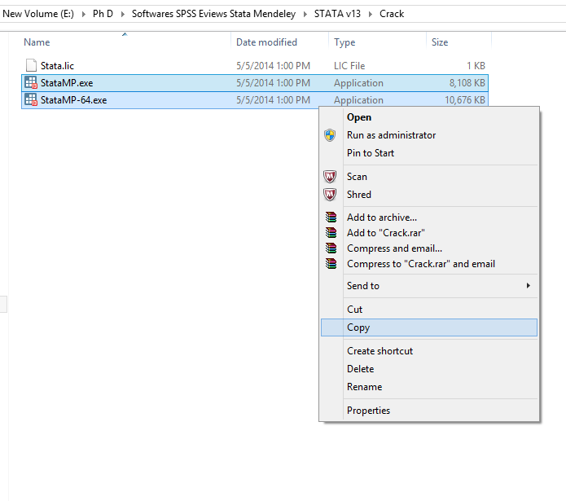
STATA Installation
12. Step 12: Go to the STATA v13 folder in your pen drive. Open the Crack folder. Select the two .exe files as shown above and copy both files.
13. Step 13: Go to C Drive and open Program Files (x86) folder. Locate folder named “Stata 13” and open it. Paste the above two copied files here. Double click on ‘StataMP.exe’ file and STATA shall open. You can also right click on “StataMP.exe” file and create a desktop shortcut for it.

Slide 37
Mendeley Installation…

Slide 38
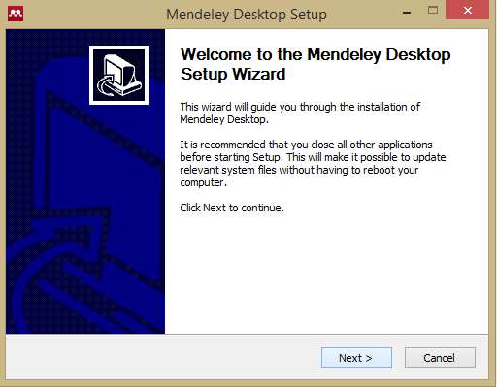
Mendeley Installation
Please follow the steps below to install Mendeley on your system:
Step 1: Open the folder named ‘Mendeley’ in your SanDisk pen drive
Step 2: Double click on “Mendeley-Desktop-1.15.1-win32” file
Step 3: A dialog box called “User Account Control” appears. Click on YES.
4. Step 4: Mendeley desktop wizard set up opens as shown above. Click on ‘Next’

Slide 39
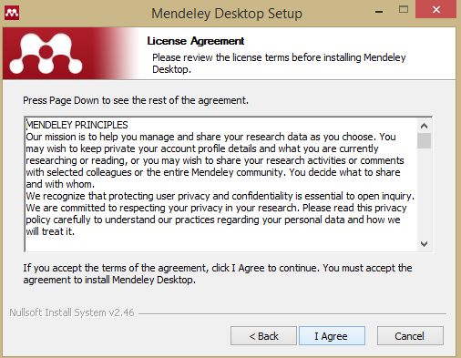
Mendeley Installation
Step 5: The License Agreement dialog box appears. Click on ‘I agree’.
Step 6: The Choose Install Location dialog box appears. Click on “Next”. The software is stored in C Drives’ Program Files (x86) folder by default.

Slide 40
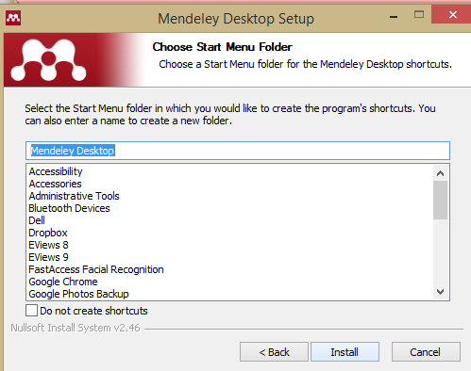
Mendeley Installation
Step 7: The Start Menu Folder dialog box appears as shown above. Click on “Install”. The installation begins.

Slide 41
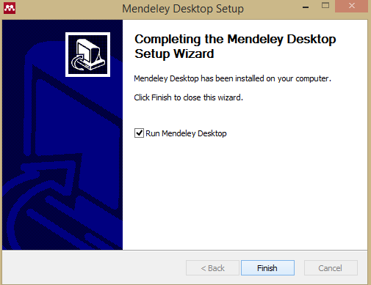
Mendeley Installation
8. Step 8: The set up completion dialog box appears. Click on ‘Finish’.

Slide 42
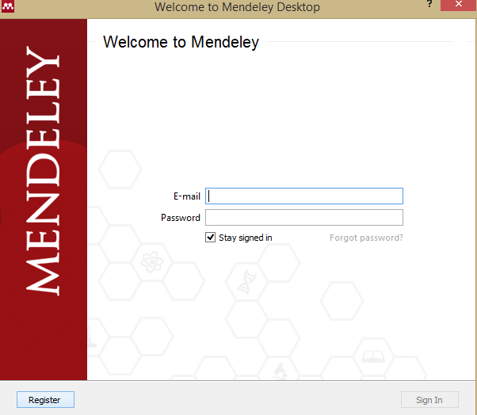
Mendeley Installation
9. Step 9: The Welcome to Mendeley window appears. Click on “Register” on the bottom left. Now, you should be connected to the internet to make your account on Mendeley.

Slide 43
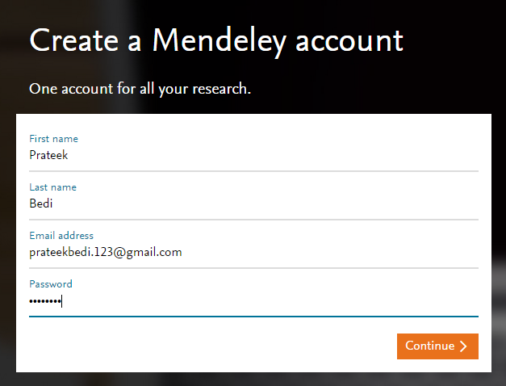
Mendeley Installation
10. Step 10: If you are connected to the internet, you shall be taken to the registration window as shown above. Fill in your details. Click on ‘Continue’.

Slide 44
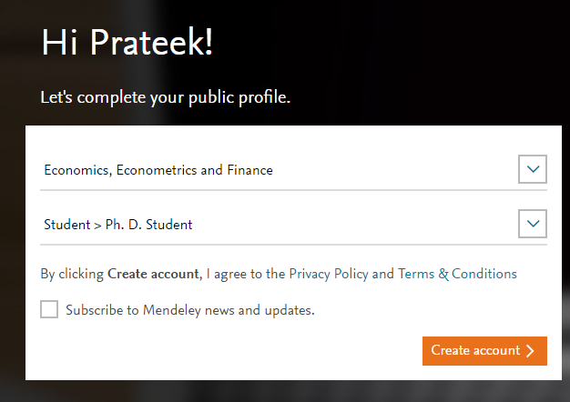
Mendeley Installation
11. Step 11: The window as shown above appears. Select your field of study and Academic Status. Click on ‘Create Account’.

Slide 45
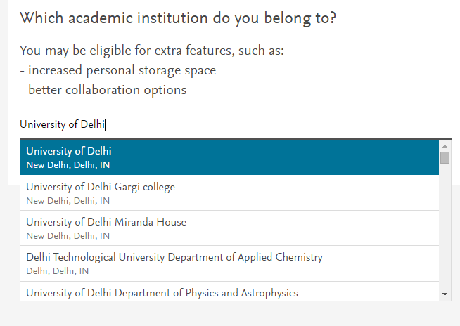
Mendeley Installation
Step 12: The window as shown above appears. Type in and select your Academic Institution. Click on “Save and Continue”. Your account has been created.
Step 13. Go to the Mendeley Icon on your desktop. Double click on it and enter your email id and password. Click on Sign In. (You should be connected to internet to open Mendeley).

Slide 46

Wish you all the best…
Enjoy working with the software and leverage their capabilities for your advantage!
Enjoy working with the software and leverage their capabilities for your advantage!

Slide 47


